Slide 1
Calibrator Logic Map

Slide 2
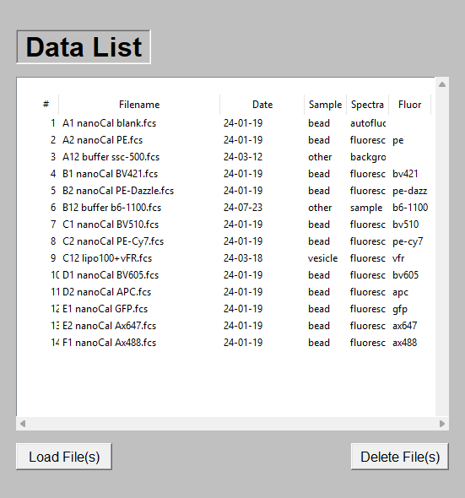

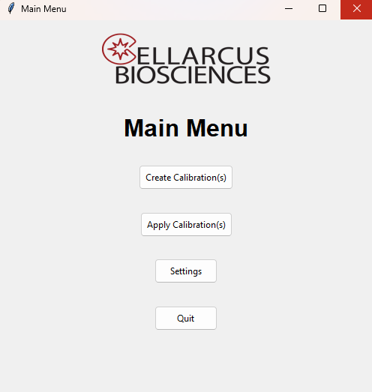
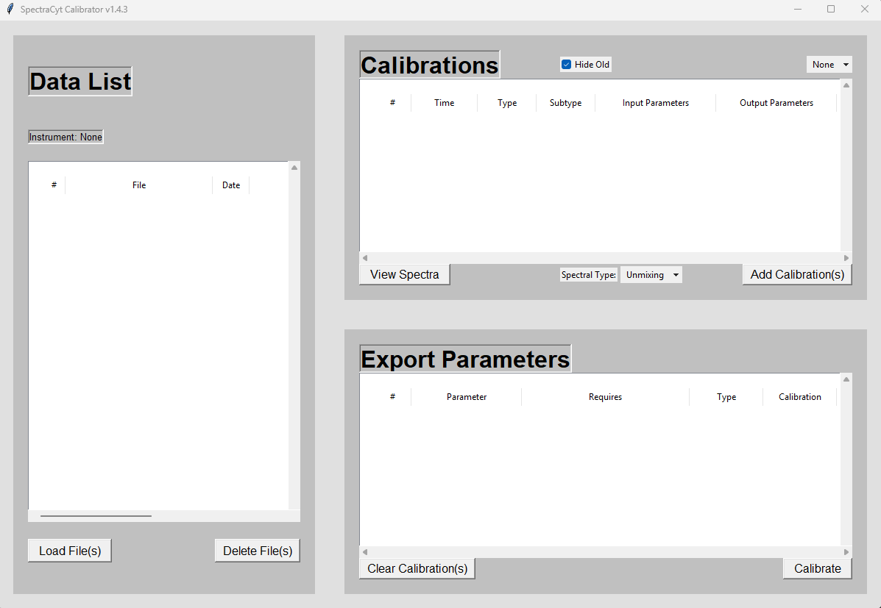
Main Menu
CalibrationWindow
CalibrationIO
Exports json of calibrations
Exports json of spectra
Includes metadata
DataSet:
Calibration: True
CalibrateFilesWindow
SettingsWindow (WIP)
Not implemented yet
DataSet:
Calibration: False

Slide 3
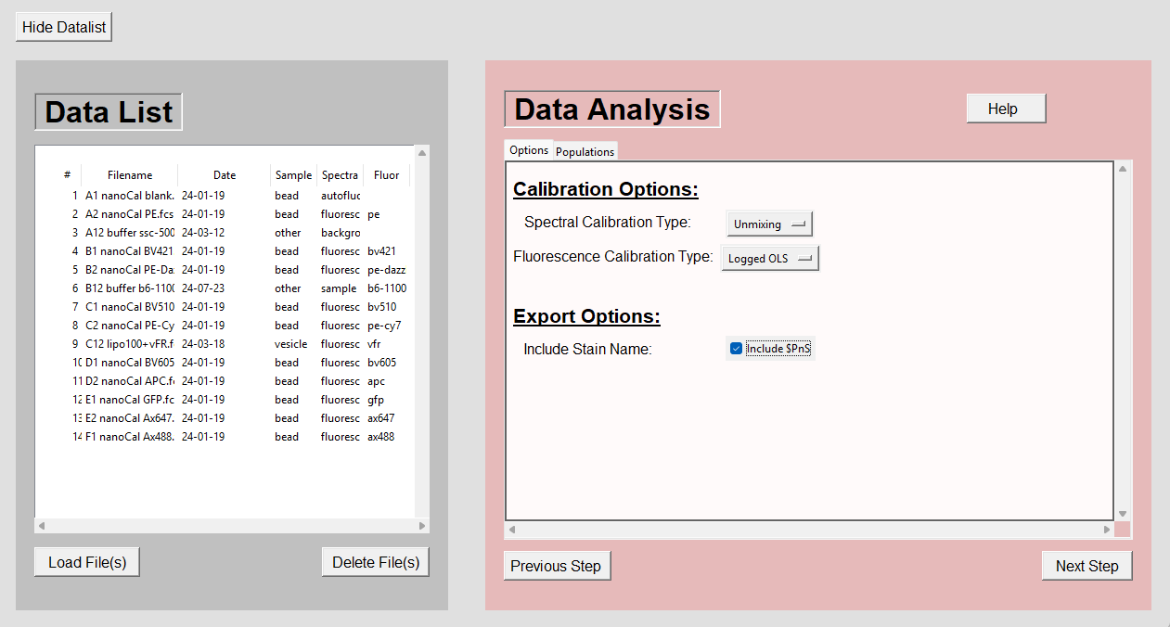
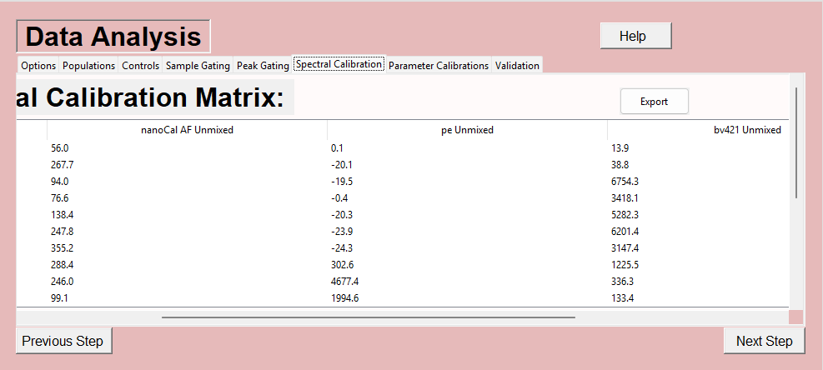
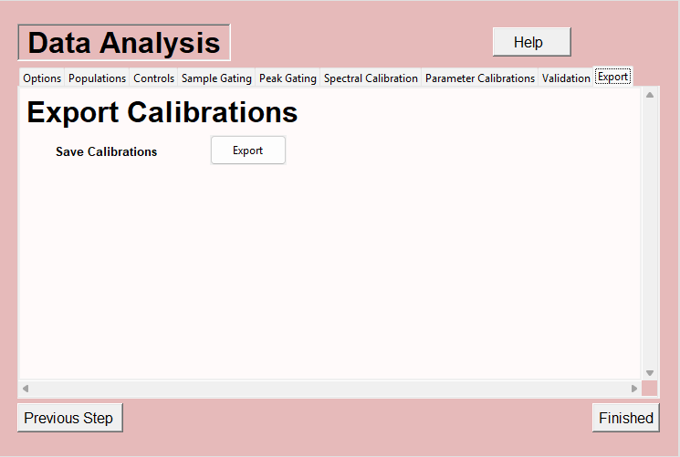
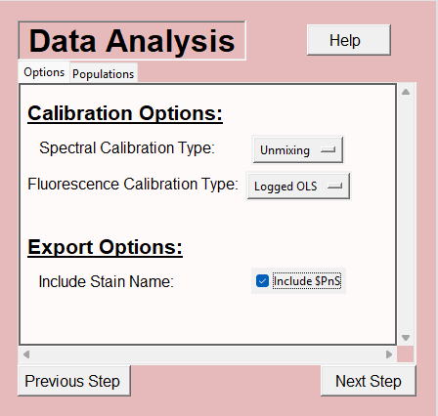
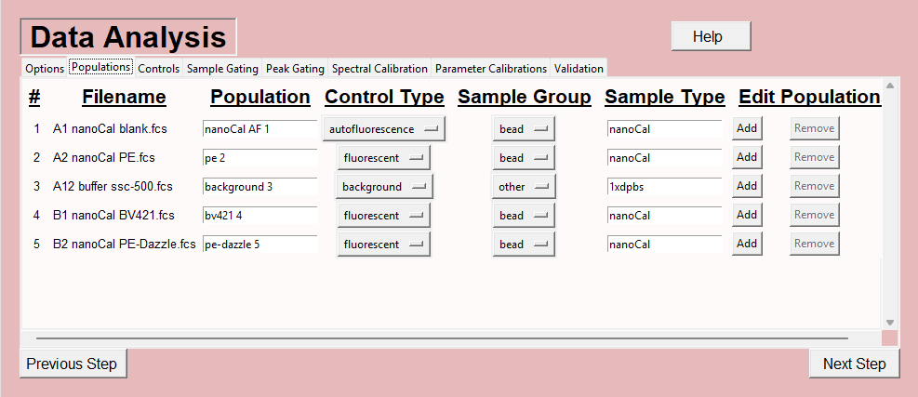
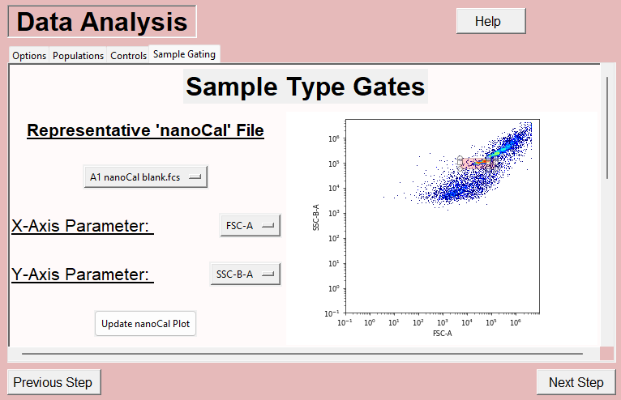
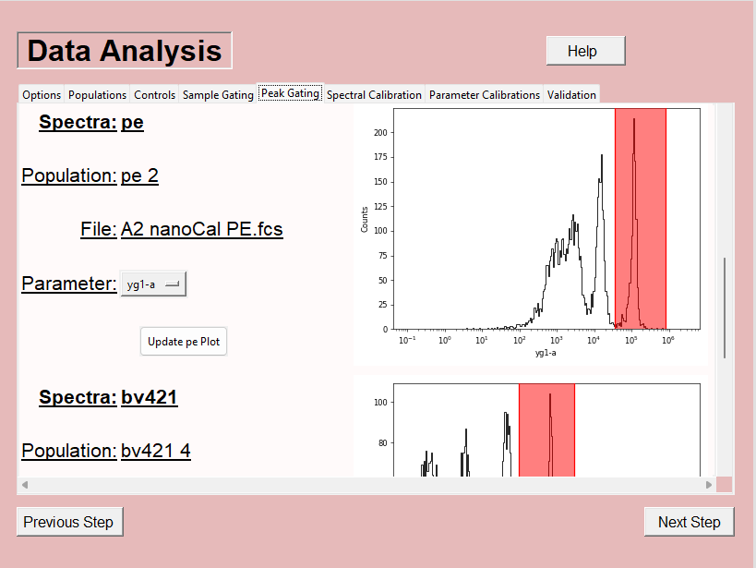
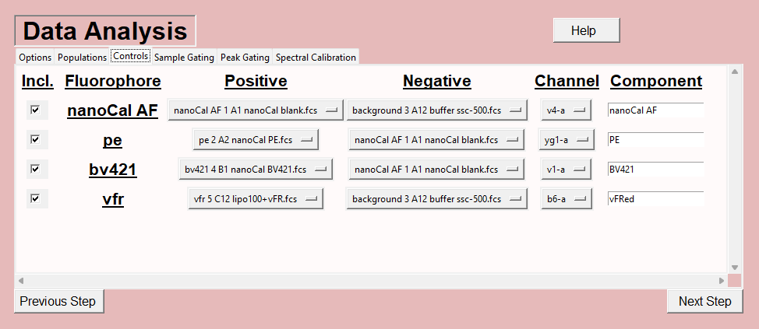
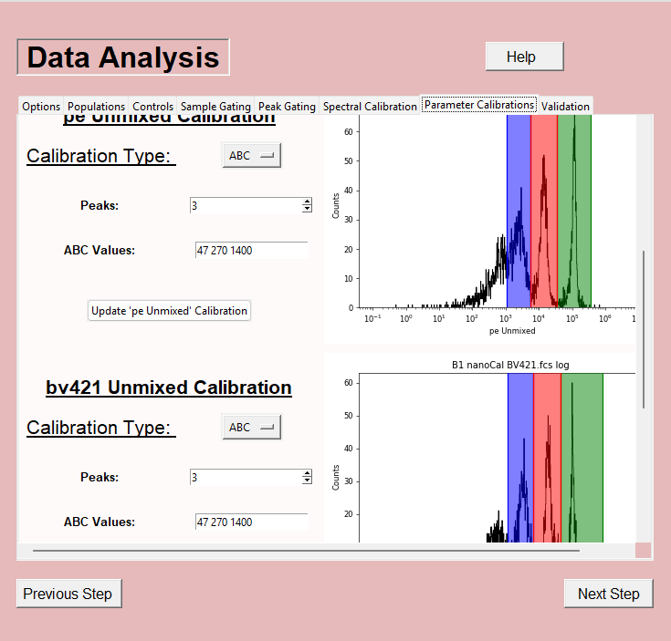
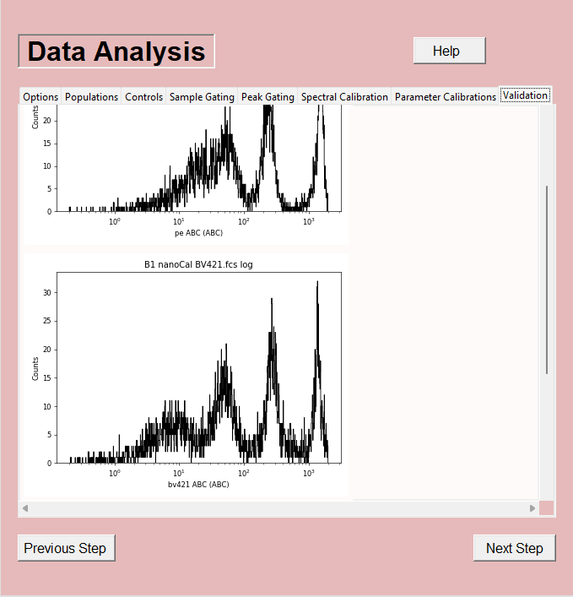
CalibrationWindow
DataView
MainMenu
Export Calibrations
CalibrationWindow
ScrollFrame(s)
SpectralCalibration
Unmixing/Compensation
Metadata
ControlRelations
Assigns controls
Defines input/output parameters
Identifies Populations
DataSet
Calibration: True
Identifies Sample Type
Identifies Fluor
Identifies Controls and Samples
Calibrations
Calibrations: ABC, MESF, Scatter, Size, Photoelectrons

Slide 4
DataSet
CalibrationWindow (GUI)
DataView (GUI)
ControlRelation
Assigns controls
Defines input/output parameters
Identifies Populations
DataFile(s)
Each DataFile:
DataSet
Identify Common Parameters
Only these parameters will be used
Identify Instrument Make(s) and Model(s)
Should only be 1 Make and Model
Load DataFile(s)
Can be a calibration dataset or not
Sample
Sample identify logic using filename, keywords, filepath
Sample Type
Sample group
Load Files
Calibration Datasets
Fluorophore
Fluorophore identify logic using filename, keywords, filepath
Fluorophore
Control Type
ToDo: Support Multiple Fluorophores per file.
ControlRelation
Assigns controls
Defines input/output parameters
Identifies Populations
Instrument (WIP)
Trigger Channel and Threshold
Gains
Helps with vFRed

Slide 5
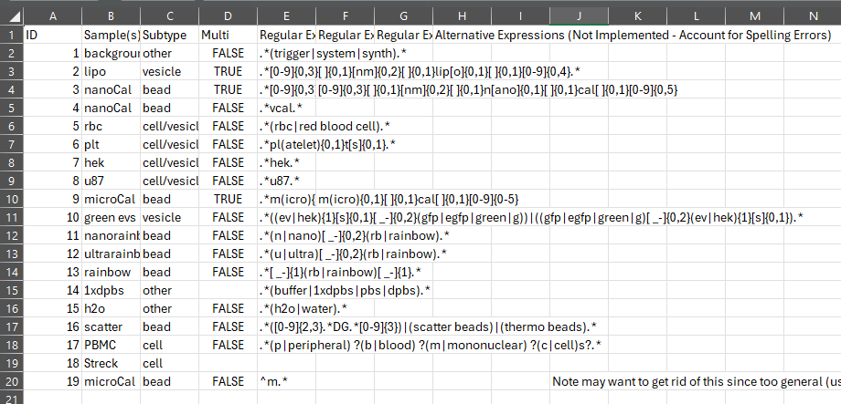
Sample
DataSet
DataFile
Sample Regex .csv: With Order of Operations
Sample
Sample identify logic using filename, keywords, filepath
Sample Type
Sample group
Fluorophore
Fluorophore identify logic using filename, keywords, filepath
Fluorophore
Control Type
ControlRelation
Assigns controls
Defines input/output parameters
Identifies Populations
Instrument (WIP)
Trigger Channel and Threshold
Gains
Helps with vFRed

Slide 6
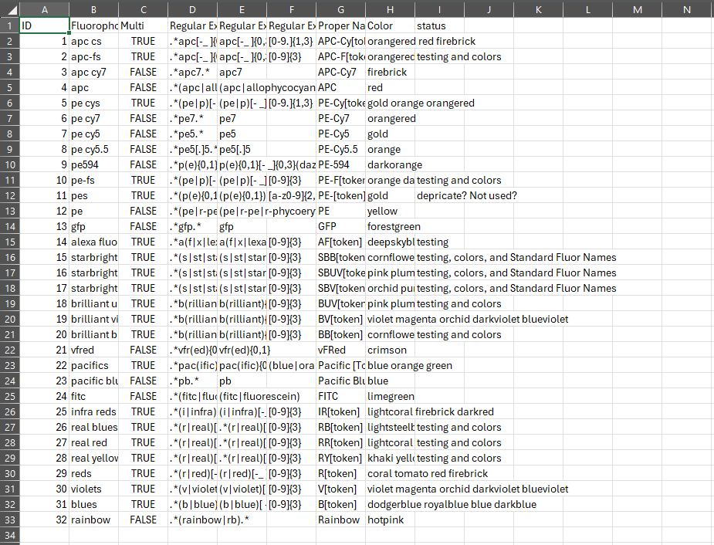
Fluorophore
DataSet
Fluorophore Regex .csv: With Order of Operations
DataFile
Fluorophore
Fluorophore identify logic using filename, keywords, filepath
Fluorophore
Control Type
Sample
Sample identify logic using filename, keywords, filepath
Sample Type
Sample group
Instrument (WIP)
Trigger Channel and Threshold
Gains
Helps with vFRed
ControlRelation
Assigns controls
Defines input/output parameters
Identifies Populations

Slide 7
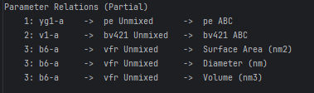
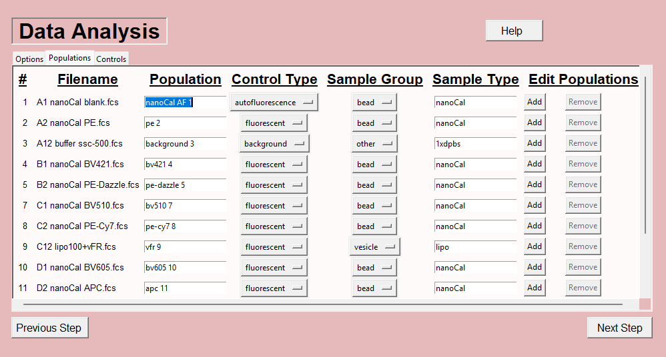
ControlRelations
ControlRelations: Parameter Relations
CalibrationWindow
ControlRelations
Assigns controls
Defines input/output parameters
Identifies and operates on Populations
Raw Parameters
Unmixed Parameters
Calibrated Parameters
SpectralCalibration
Unmixing/Compensation
Metadata
Assigned Controls for Unmixing/Compensation
Calibrations
Calibrations: ABC, MESF, Scatter, Size, Photoelectrons
Population(s)
Population = DataFile + Sample Gate
Used for calibrations

Slide 8
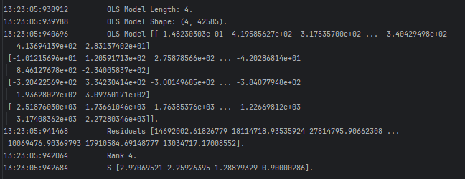
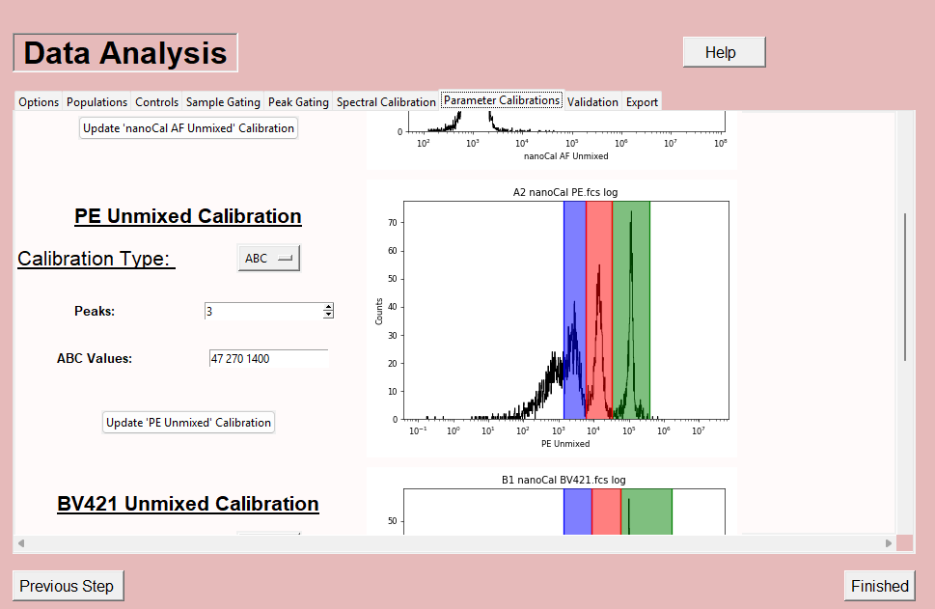
SpectralCalibration
ControlRelation
Organized controls used for unmixing/compensation
Planned parameter names
CalibrationIO
Exports json of calibration and metadata
SpectralCalibration exported as spectra that may be reconstructed as compensation or unmixing matrix
Unmixed Parameters for Calibration
SpectralCalibration
Unmixing/Compensation Matrix
Generates unmixed/compensated parameters
Types: Unmixed, Unmixing, Compensation
Normalized: Sum, Max, None
Metadata
Calibrations
Calibrations: ABC, MESF, Scatter, Size, Photoelectrons
CalibrationWindow

Slide 9
CalibrationWindow (GUI)
Calibrations
CalibrationWindow (GUI)
ControlRelation
Organized controls used for unmixing/compensation
Planned parameter names, inputs
Calibrated Parameters
Calibrations
Calibrations: ABC, MESF, Scatter, Size, Photoelectrons
Unmixed Parameters
MESF Calibration
Raw Parameters
Scatter Calibration
ABC Calibration
SPE Calibration
Fluor Size Calibration
CalibrationIO
Exports json of calibration and metadata

Slide 10
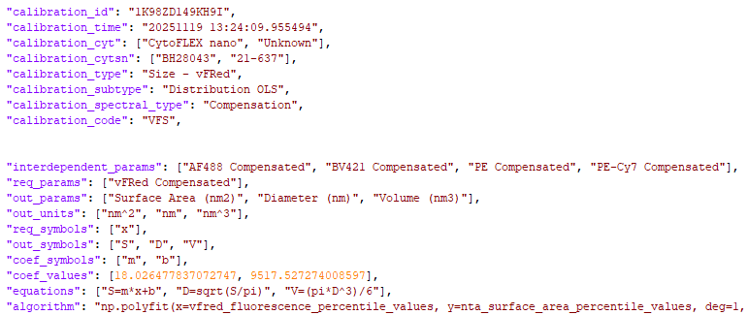
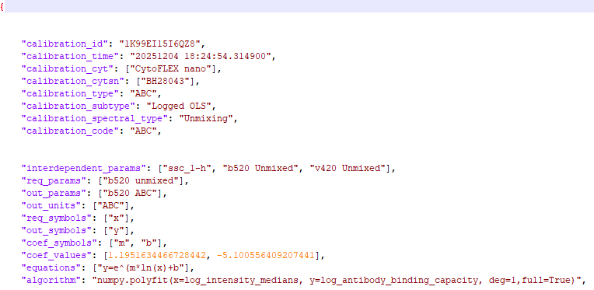
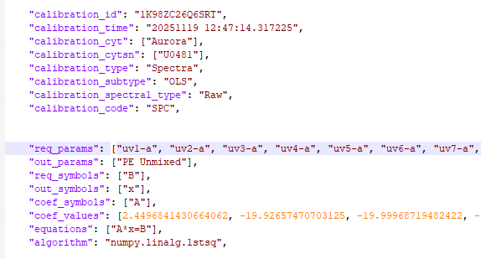
CalibrationIO
CalibrationIO
Exports json of calibrations
Exports json of spectra
Includes metadata
CalibrationWindow (GUI)
Calibrated Parameters exported as calibrations
Unmixed Parameters exported as Spectra
Calibrated Parameters
Antibody Binding Capacity (ABC)
Mean Equivalent Soluble Fluorophore (MESF)
Equivalent Reference Fluorophores (ERF)
Diameter (nm)
Surface Area (nm2)
Volume (nm3
Scattering Cross-Section (nm2)

Slide 11
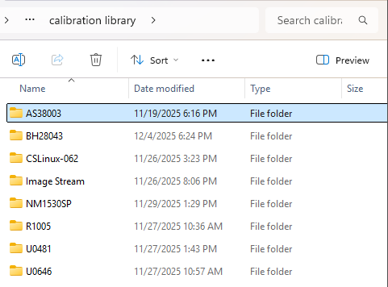
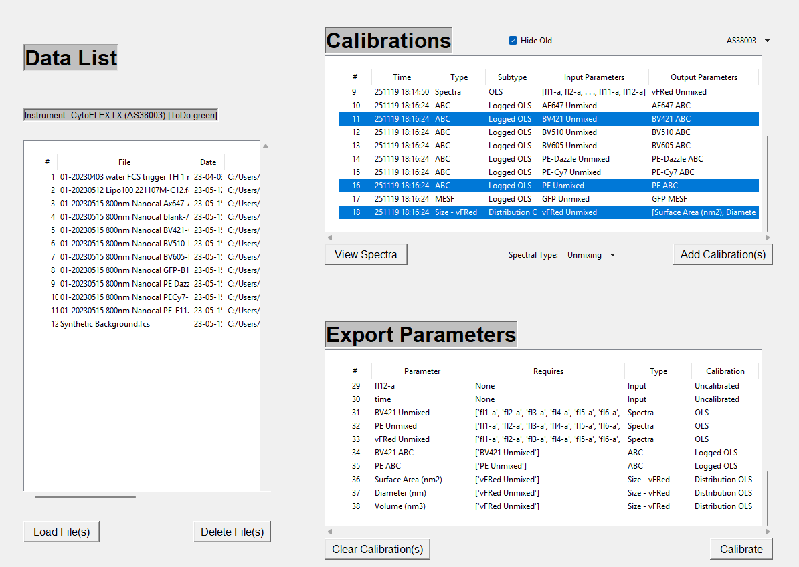
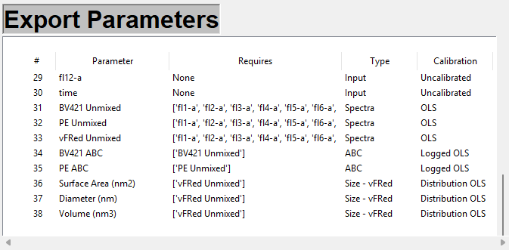
DataSet
Calibration: False
Identifies Sample Type
Identifies Fluor
Identifies Controls and Samples
CalibrateFilesWindow
Calibration Library
CalibrateFilesWindow
Calibrations read based on instrument serial number
Add Calibrations: Adds associated calibrated parameters to the export parameter list
Raw Parameters
FileCalibration
Compiles calibrations in an order that allows calibrated parameters to depend on each other
Runs “Calibrations” on Data in the “Data List” and exports them with the “Export Parameters” added.
Unmixed Parameters
Calibrated Parameters

Slide 12
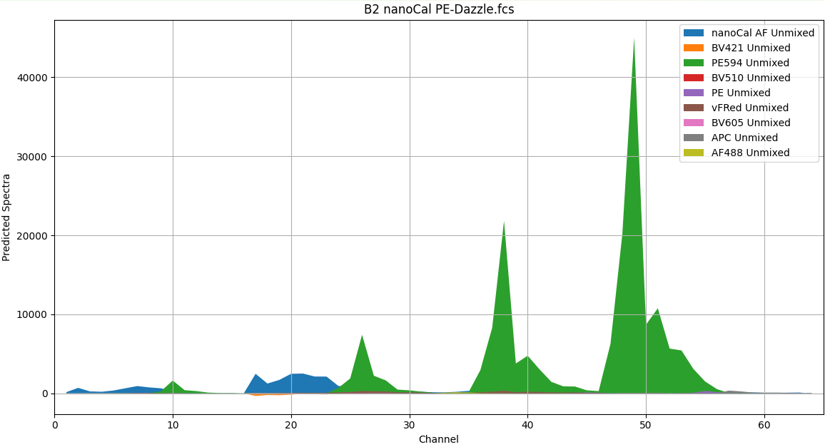
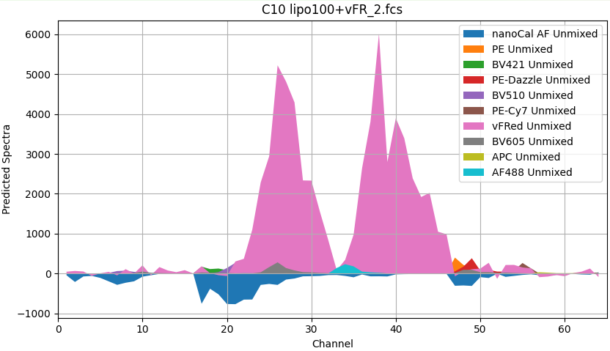
CalibrateFilesWindow
FileCalibration
Calibrated Parameters
Antibody Binding Capacity (ABC)
Mean Equivalent Soluble Fluorophore (MESF)
Equivalent Reference Fluorophores (ERF)
Diameter (nm)
Surface Area (nm2)
Volume (nm3
Scattering Cross-Section (nm2)
Compile Calibrations
Compiles calibrations using an order of operations to ensure calibrations have required dependencies.
Creates a list of expected calibrated parameters for export
Calibrate File(s)
Constructs an unmixing/compensation matrix from selected spectra.
Unmixes/compensates data
Can generate residuals and predicted values for the raw parameters allowing raw parameters to be compared to those predicted by the model
Calibrates
FileCalibration
Compiles calibrations in an order that allows calibrated parameters to depend on each other
Runs “Calibrations” on Data in the “Data List” and exports them with the “Export Parameters” added.
Spectral Overlay of Unmixed Components (In Progress)

Slide 13
Automated Calibration (WIP)
ToDo: Automated Gating Functions
SpectralCalibration
Unmixing/Compensation
Metadata
Filepaths from GUI
ControlRelations
Assigns controls
Defines input/output parameters
Identifies Populations
Calibrations
Calibrations: ABC, MESF, Scatter, Size, Photoelectrons
DataSet
Calibration: True
Identifies Sample Type
Identifies Fluor
Identifies Controls and Samples
CalibrationIO
Exports json of calibrations
Exports json of spectra
Includes metadata
Calibrated Data
ToDo: filepaths/dirpaths
Raw Data
For calibration creation
For calibration application
FileCalibration
Compiles calibrations in an order that allows calibrated parameters to depend on each other
Runs “Calibrations” on Data in the “Data List” and exports them with the “Export Parameters” added.

Slide 14
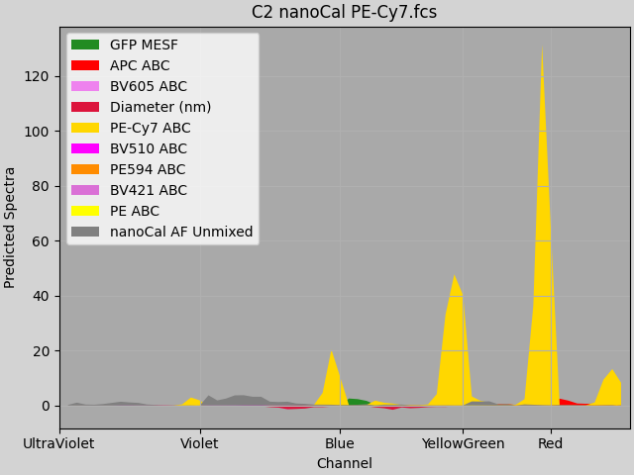
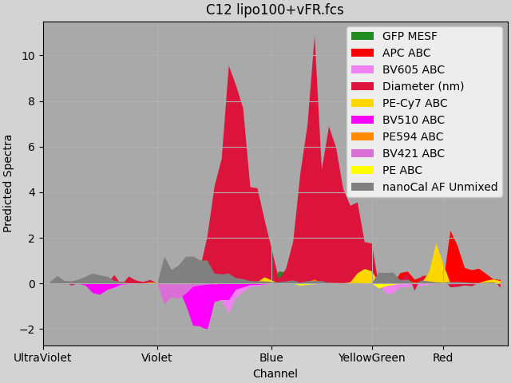
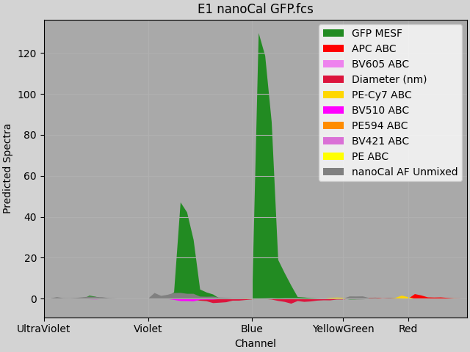
Calibrated Parameters
Antibody Binding Capacity
Measure of Antibody Binding
Specific to a Fluorophore and Antibody combination
Size (Fluorescent)
Estimates size using dye the stains proportionate to Surface Area
Depends on a lipid surface that dye can stain
Assumes that the particle has a fully lipid surface (not always true)
Mean Equivalent Soluble Fluorophore
Measure of fluorophore Intensity
Fluorophore specific
Equivalent Reference Fluorophores
Measure of Intensity
Meant to be universal across fluorophores/antibodies
Size (Scatter)
Estimates size using Mie Theory to estimate size from scatter.
Assumes known refractive index (not same for every particle)

Slide 15
Appendix
Missing Autofluorescence: Finding dimmest blank peak
Synthetic Background Generation
Fluorophore Identification Logic
Sample Type Identification Logic
Planned: Antibody Identification, Expanded Instrument Settings Identification

Slide 16
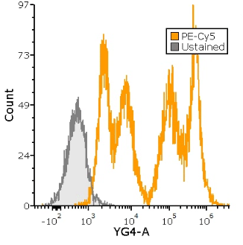
Dimmest Blank – Missing Autofluorescence
Autofluorescence only beads improve unmixing in cases where non-specific binding is present.
Dimmest blank is used in cases where there is no Autofluorescence control
Integrated 10th Percentile used to find the dimmest of the blank peaks of the stained beads
Less effective in high noise controls
Possible Ways to Improve:
Implement it on gated events where noise is reduced
Some way of identifying presence of a blank peak (spectra differences at different percentiles)
Non-Specific Binding
Blank Peak of Stained
Unstained Bead

Slide 17
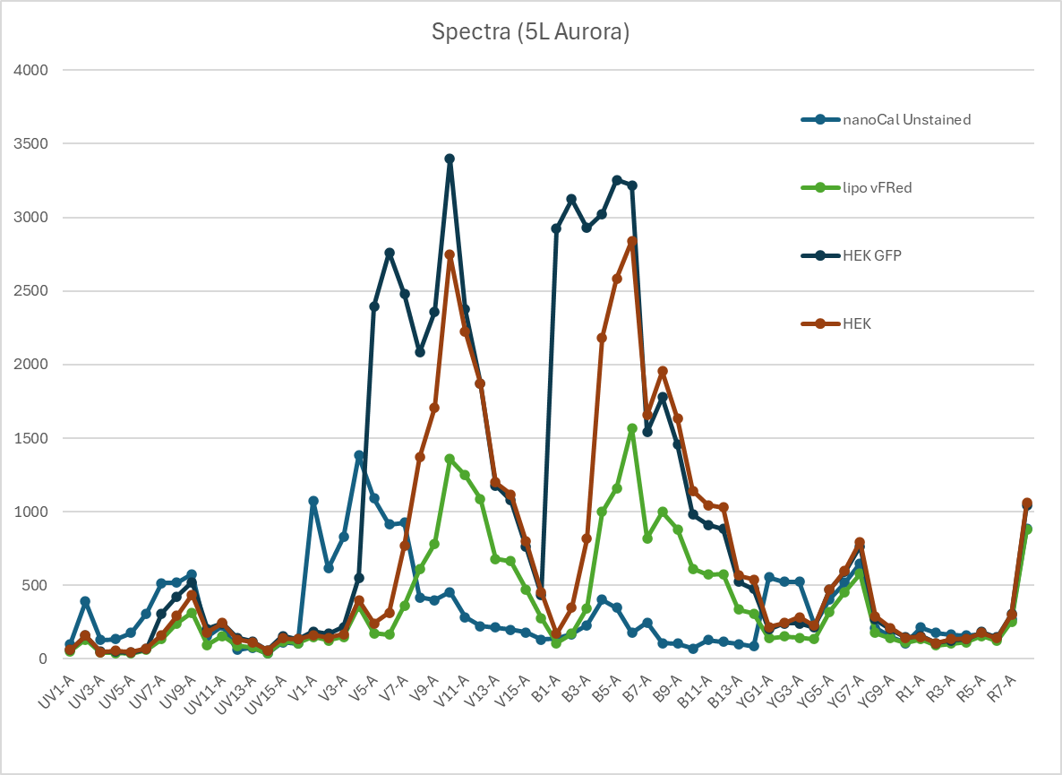
Synthetic Background – Missing SSC Buffer
Used when background control is missing
Helps extract autofluorescence spectra
Derived from input data and attuned to instrument
How it works:
Combine all input data into one artificial file
Separate events by each parameter and break into chunks
For each parameter take the minimum median/mean of each chunk
Recombine minimum chunks into a new file made from parameters from across the files
Works best with a variety of spectra in inputs
Synthetic Background
Generated Synthetic Background Spectra

Slide 18
Sample Type/Group Identification Logic
Get trigger/gain information
Finds match of sample type regex for each relevant keyword
First found given priority
Order of Operations to reduce false positives/negatives
Eg. buffer only or 1xdpbs assumed to be a background control even if other types identified
More questionable identifications of a type occur later given less priority
Priority Order: Current Filename, Keywords (incl $FIL), Filepath
Filepath may be used in cases where all files in a directory are of the same type (exceptions may be identified from a higher priority source such as in the filename or keywords).
Each sample type corresponds to a broader sample group (Cells, EV’s, Bead’s, Other)
Match filepath only in cases where no information found in keywords or current filename
Attempt to identify sample group if sample type identification failed. Default to other.
Resolve sample group ambiguity (eg RBC Cells vs RBC EV’s). vFRed if present assumed to be EV.

Slide 19
Spectra Type (Fluorophore) Identification
Inputs sample type from Sample Identification
Identify fluorophore or fluorophore group
Seeks autofluorescence first giving it priority (if something says unstained pe it is assumed unstained).
Currently identifies first fluorophore found then returns (ToDo handle multiple fluorophores).
Extract fluorophore string identified in text (eg filename or keyword value)
Check if identified fluorophore was a group (eg BV’s) or an individual fluorophore (eg PE).
If necessary identify individual fluorophore from group (eg BV421 or BV605)
Identifies individual fluorophore from a group based on a characteristic specified for each group (eg for “BV421” it would be the “421”)
Generates a standardized proper name for each fluorophore (so unmixed/calibrated parameters names are common for a given fluorophore regardless of the instrument.

Slide 20
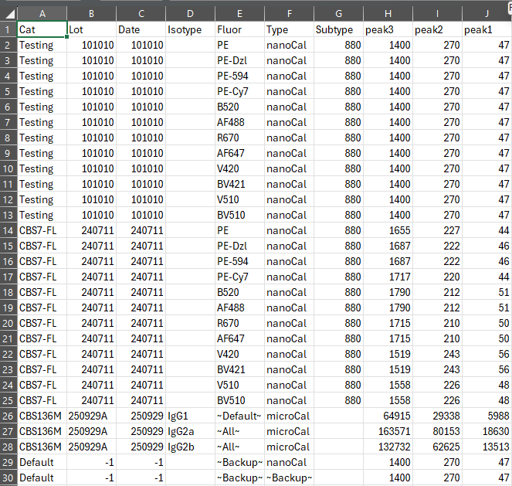
Lot and COA Values Identification
Filter by sample type
Include sample default as well as an option in case of no lot identified for given sample type
Filter by fluorophore
Include fluorophore default if present for a given sample type
Identify priority lot based on date
Disqualify lots newer than file acquisition date
Set priority as lot where date is closest to acquisition date
Use priority as default chosen menu option
Get all valid lots as additional options for menu
Convert necessary information to strings for filling out widgets
Values may be identified as “blank”, “dim”, “medium”, “bright” or as peak1 – peakn (peak0 if present refers to “blank”)
Fill in option menu and values entry box on gui.

Slide 21
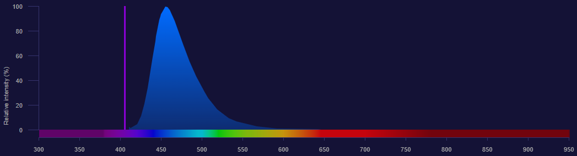
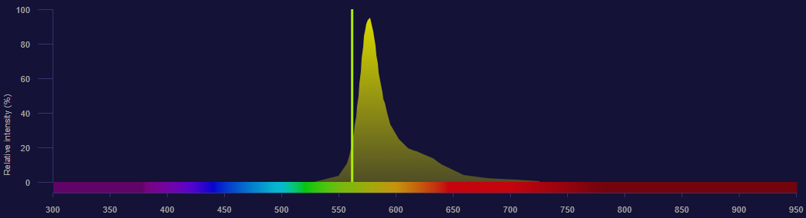
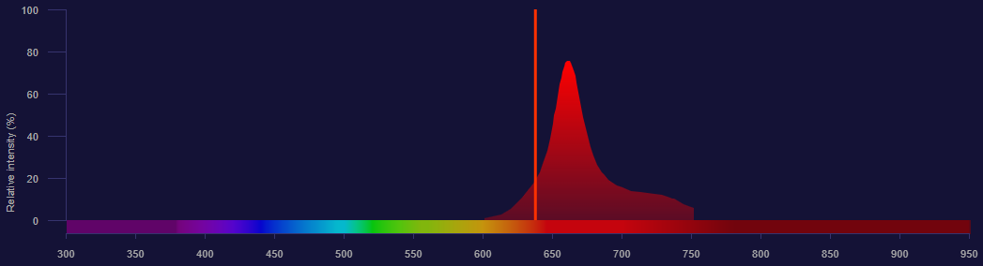
Residuals and Predicted-Detector/Raw Plots
Predicted Detector Values by the model
P(FL1)
P(FL2)
P(FL3)
P(FL4)
P(FL5)
P(FL6)
Pacific Blue Spectra (sp1)
um1
Unmixed Abundances
PE Spectra (sp2)
um2
APC Spectra (sp3)
um3
Residual(s) (difference between observed and predicted

